Slide 1


SUM
AYSHA
NIDA
MOHAMMED

Slide 2
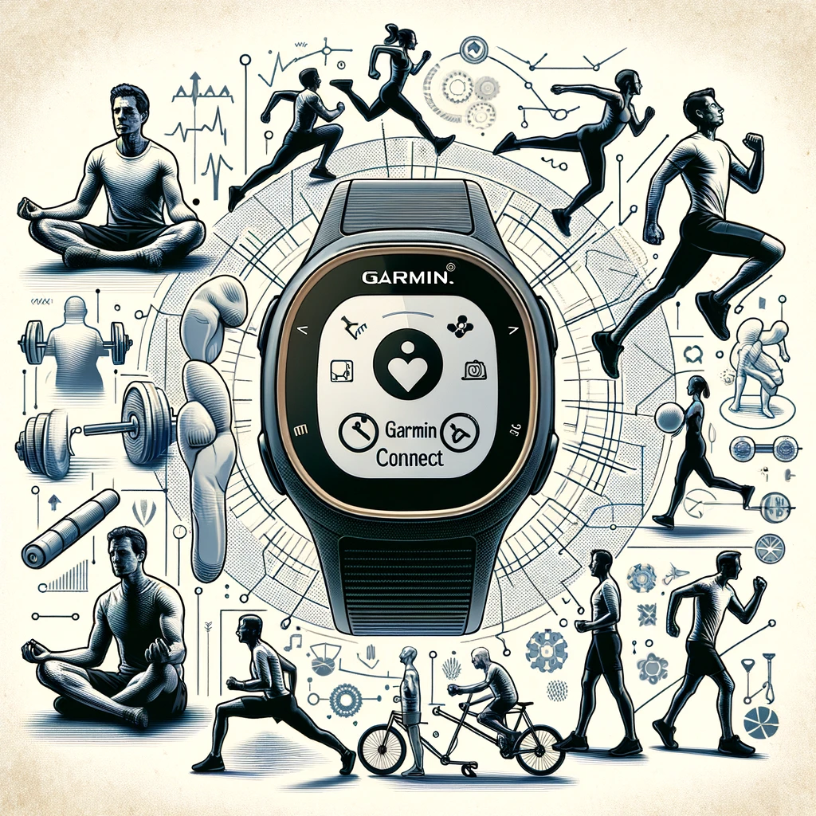
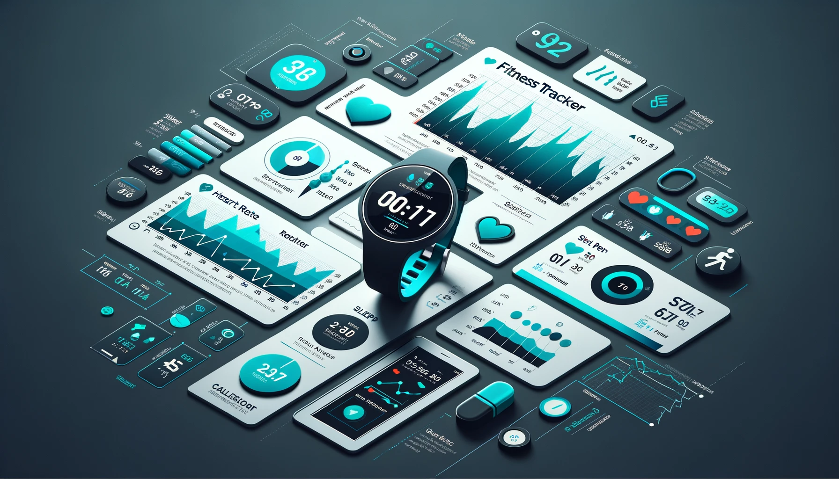
This is the story of a man and his one true love…
12.2%
of Americans use a smartwatch or a fitness tracker.
14.4%
World’s population that uses a smart wristband device
Source: Dataportal
… his fitness tracker.
Notes:
This is the story of a story of a man and his one true love … his Garmin Connect.
But he is not alone – according to research by Dataportal in 2023, 14.4% of the world’s population used a smart wristband device - that’s approximately 1.138 billion people.

Slide 3
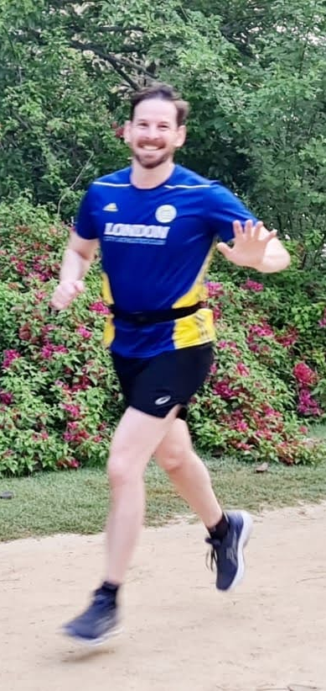
PROJECT OVERVIEW
ETHICAL CONSIDERATIONS
Transforming Fitness Data into Actionable Insights.
Develop a data engineering solution to analyse fitness patterns from Garmin wearable devices.
Anonymized data from a Garmin Connect watch, used with consent.
To structure rich datasets into a database, enabling visualization and tracking of health and fitness.
Ethical Considerations
Commitment to Privacy and Ethics in Data
Informed Consent
Data provided voluntarily for non-commercial use.
Anonymity
Analysis ensuring individual privacy and confidentiality.
Ethical Use
Data handling aligns with high ethical values, prioritizing user trust and integrity.
Building a Foundation for Data-Driven Fitness Analysis
Expandable Model
Ready to integrate additional data following ethical guidelines.
Research and Development
Aiding individuals and researchers in understanding physical activity.
Data Protection
Ongoing commitment to robust privacy and data security practices.
GOAL
DATA SOURCE
PURPOSE
FUTURE OUTLOOK
PRIVACY FIRST
Strict adherence to privacy, with no personally identifiable information (PII) used.
Designed for expansion, adding more data under strict ethical standards.
SCALABILITY
Notes:
Sum - Basic motivation for the project and ethical considerations *layout needs work*

Slide 4
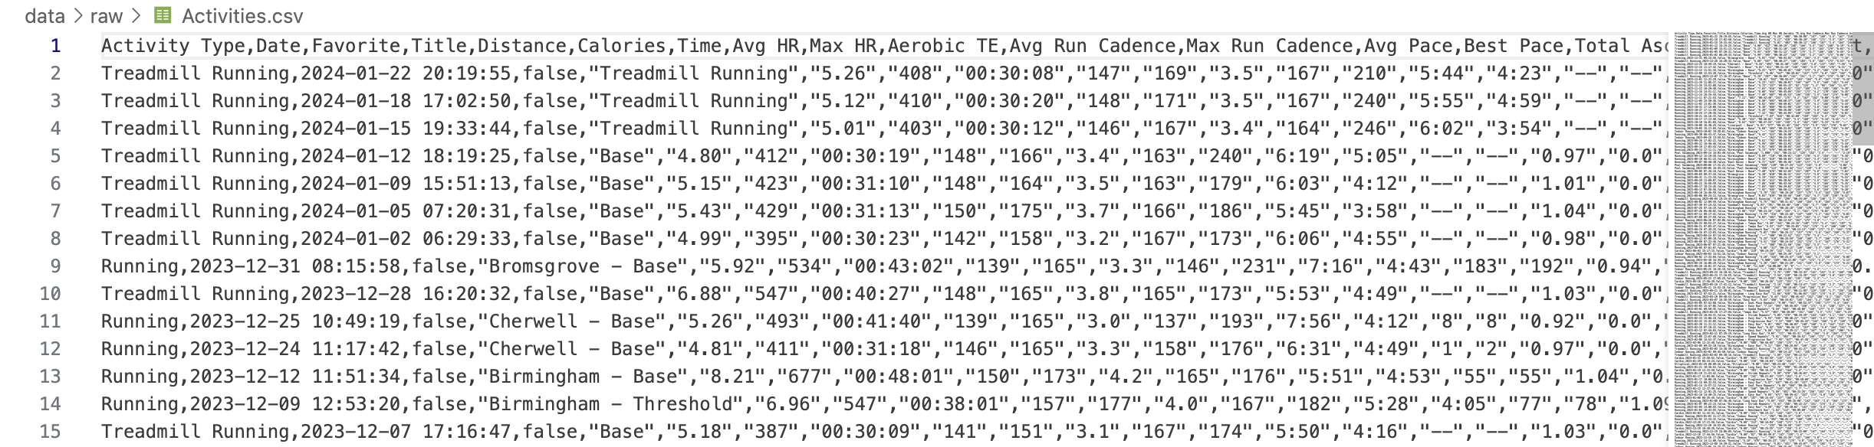
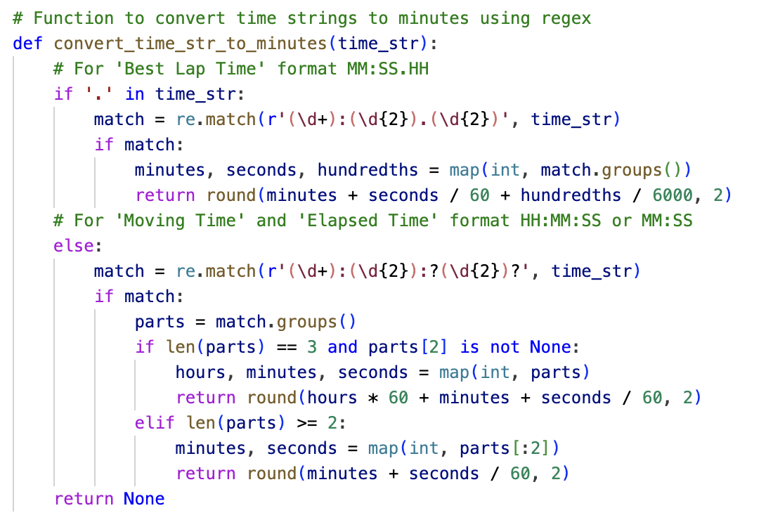
ETL PROCESS
TRANSFORMATION
Data type conversions
Convert date and time strings to datetime objects.
Cleaning missing or invalid values
Remove rows with missing or invalid data.
Feature engineering
Calculate additional metrics such as average pace and lap distance.
Data filtering
Retain rows for specific activity types (e.g., Running and Swimming).
Concatenation of text columns for composite keys
Combine Activity ID and Activity Type ID to create unique metric IDs.
Resetting DataFrame indices
Reset DataFrame indices to ensure consistency and avoid index-related errors.
LOADING
activities.csv
Contains basic details about each activity, such as activity ID, activity type ID, date, and title.
activity_types.csv
Provides a reference table for activity types, with unique activity type IDs and corresponding names.
performance_metrics.csv
Stores specific performance metrics for deeper analysis, including distance, calories burned, time, heart rate, and pace.
lap_metrics.csv
Captures lap-specific metrics such as lap time, number of laps, total distance, and moving/elapsed time.
elevation_metrics.csv
Records elevation-related metrics, including total ascent, total descent, and minimum/maximum elevation.
Notes:
Nida – Describe raw data and transformation process
The raw data included 413 entries from July 2020 across 30 different parameters (some of which were null) – since the individual granted us access to their data, we were able to start out with a single large csv file. We started with a wide range of data related to activity tracking sessions, including activity type, date, title, performance metrics, lap metrics, and elevation metrics.
Use of nbconvert
nbconvert was used in our data engineering ecosystem, primarily for its prowess in morphing Jupyter notebooks into streamlined Python .py files. This transformation is pivotal as we navigated the journey from initial data exploration towards a production-caliber code infrastructure.

Slide 5
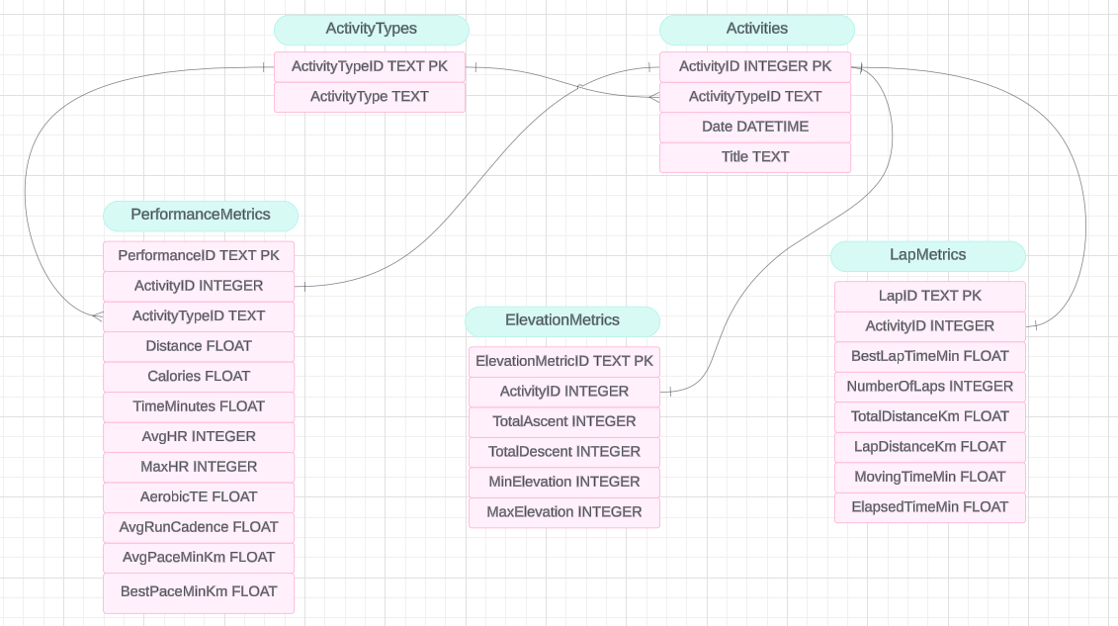
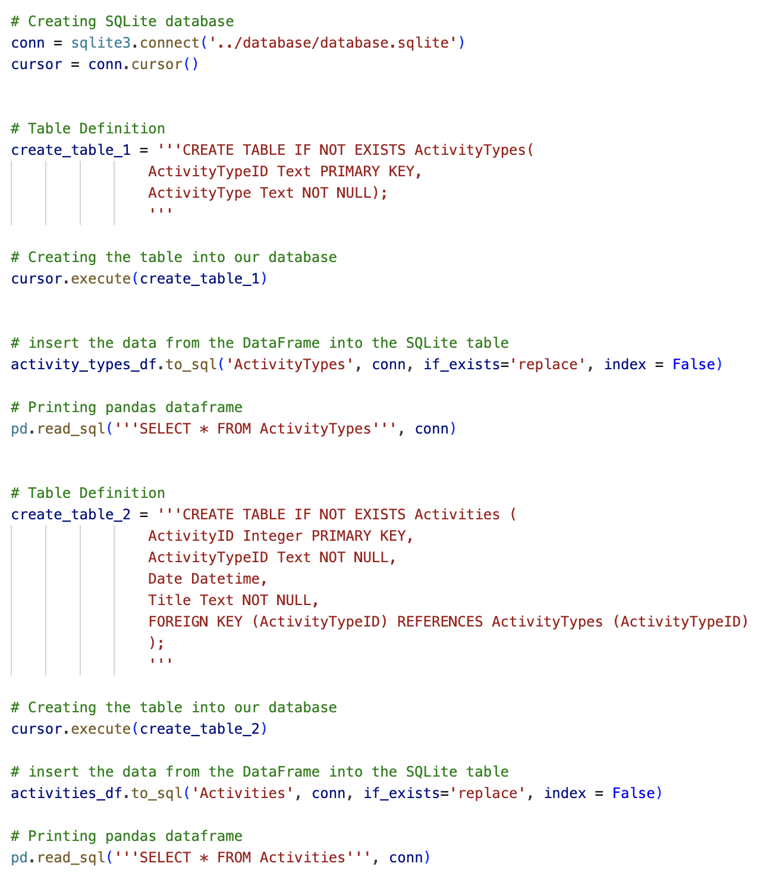
DATABASE DESIGN
ERD
SAMPLE CODE
DATABASE INTEGRITY CONSTRAINTS
Primary Keys
Each table has a primary key constraint to ensure uniqueness and identify each record uniquely.
Foreign Keys
Foreign key constraints establish relationships between tables, ensuring referential integrity and enforcing data consistency.
Unique Constraints
Certain attributes, such as ActivityTypeID and ActivityType in the ActivityTypes table, have unique constraints to prevent duplicate entries.
Notes:
Aysha – Talk through ERD and database creation
Justify use of SQLite
SQLite was chosen as the database management system due to its lightweight nature, ease of setup, and compatibility with a wide range of platforms. Overall, SQLite provides a robust relational database solution that meets the requirements of this project while offering scalability and performance for future expansion if needed.

Slide 6
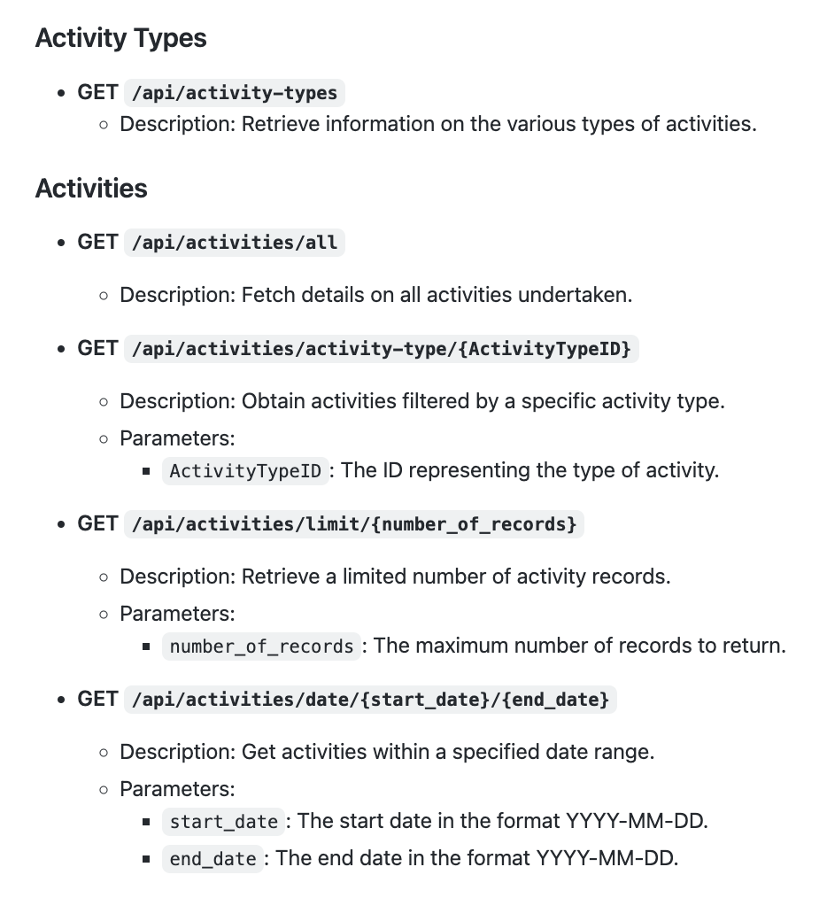
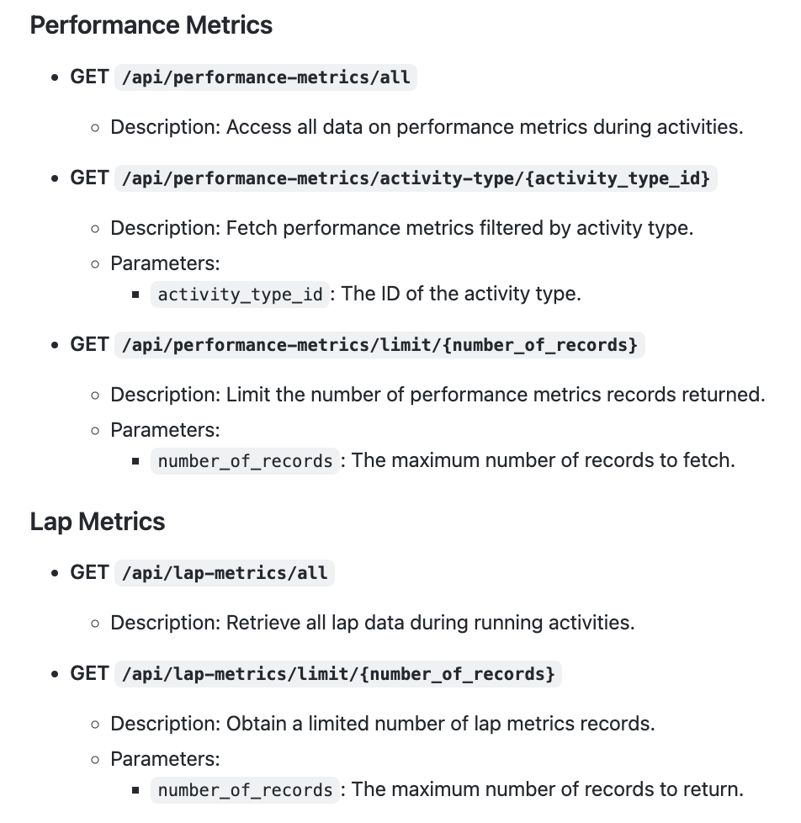
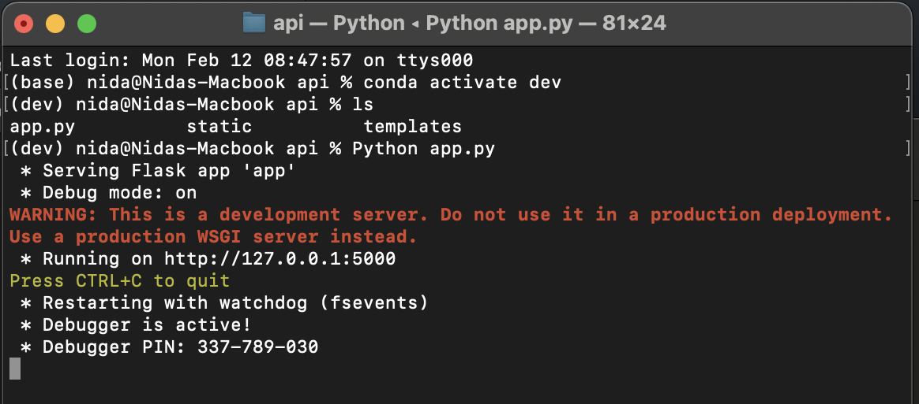
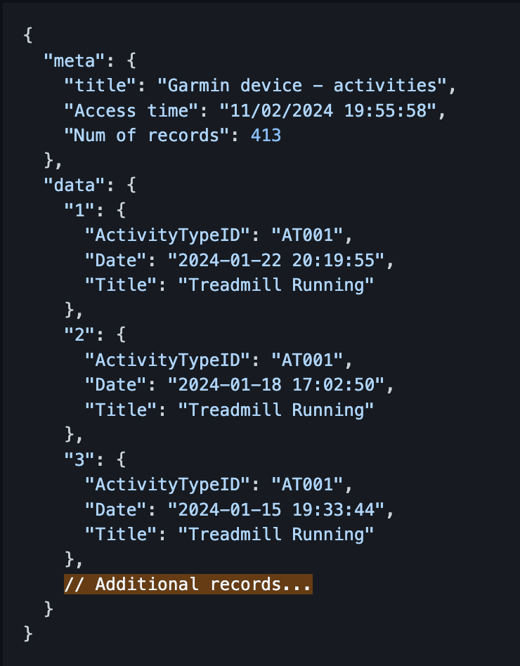
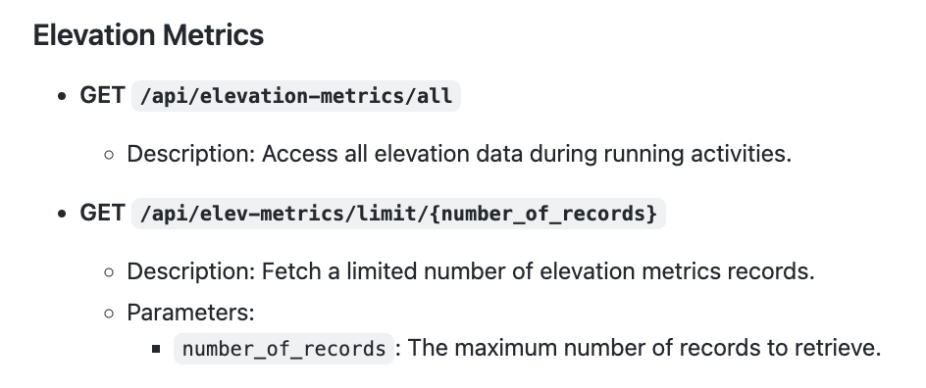
API ENDPOINTS
API
LAUNCHING FLASK APP
JSON RESPONSE STRUCTURE
The JSON response from each endpoint includes both metadata and data sections.
USAGE NOTES
Replace placeholders in curly braces {} with actual values.
The date format for endpoints involving dates is YYYY-MM-DD.
Responses are structured to include metadata for informational purposes and a data array containing the requested records.
Notes:
Mohammad – Basic flask setup + showcase

Slide 7


And they all exercised …
… happily ever after.
Notes:
QR to repo + Any questions

